Slide 1
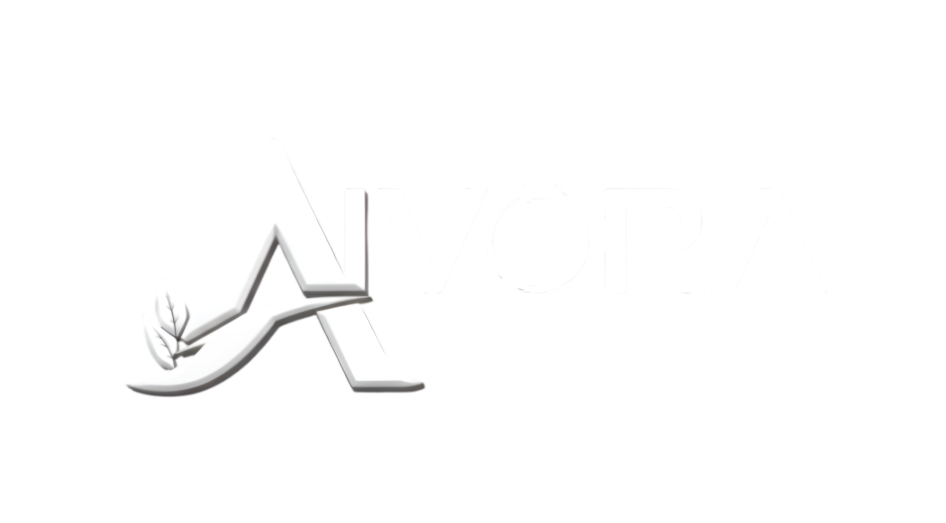

AIVORA – AI-Powered SaaS Platform
Submitted by - Niladri Banik
Subham Das
Manisha Bhuiya
Subham Giri
Supervised by - Prof. Sarasij Majumdar
TECHNO INTERNATIONAL NEW TOWN
Department of Master of Computer Applications

Slide 2
AIVORA – AI-Powered SaaS Platform for Smart Content Creation
Revolutionizing Content Creation with Intelligent Automation

Slide 3
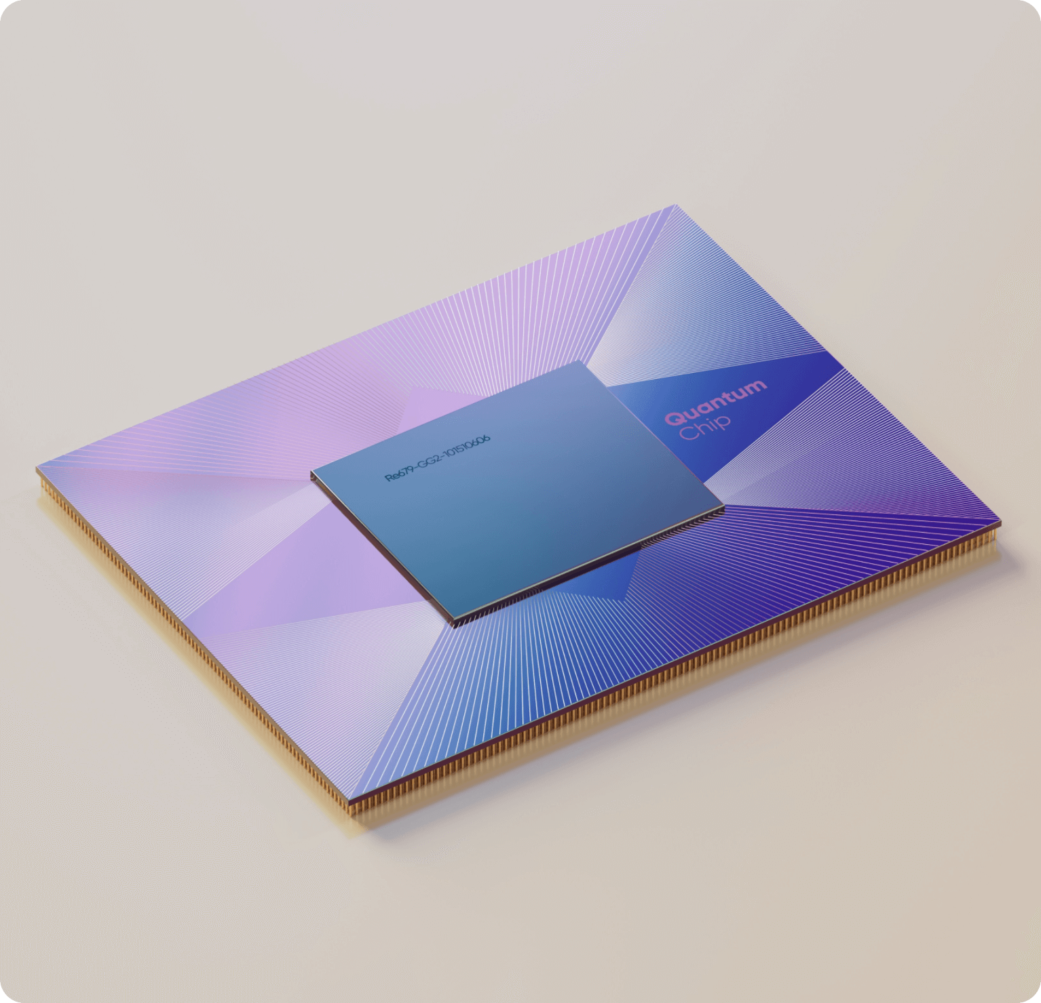
Contents
1.
Introduction And Overview
2.
Objectives And Scope of the Project
3.
Technology Stack And Project Planning
4.
Diagrams
5.
Module Interactions And Outputs of AIVORA
6.
Conclusion And Future Scope

Slide 4
Introduction
Rapid growth of digital content platforms
Increasing use of Artificial Intelligence in creativity
Traditional content creation is time-consuming
Creators need fast, intelligent, and easy-to-use tools
AIVORA provides an AI-based SaaS solution

Slide 5
Overview of AIVORA
AI-powered web-based SaaS application
Combines AI Image Generation + AI Blog Title Creation + Article Creation + Image Object and Background Removal
Built using PERN stack (PostgreSQL, Express.js, React, Node.js)
Designed for creators, students, marketers, and businesses
Focuses on simplicity, speed, and scalability

Slide 6
Project Objectives
01
Automate image creation using AI
02
Generate SEO-friendly blog titles
03
Provide a clean and responsive user interface
04
Ensure secure user authentication
05
Build a scalable cloud-based SaaS platform

Slide 7
Scope Of the Project
Excluded Features:
Included Features:
AI Image Generator
AI Blog Title Generator
User Login & Registration
Dashboard with Content History
Web-based SaaS Access
Video Editing Tools
Mobile Application
Advanced Billing (Future Scope)

Slide 8
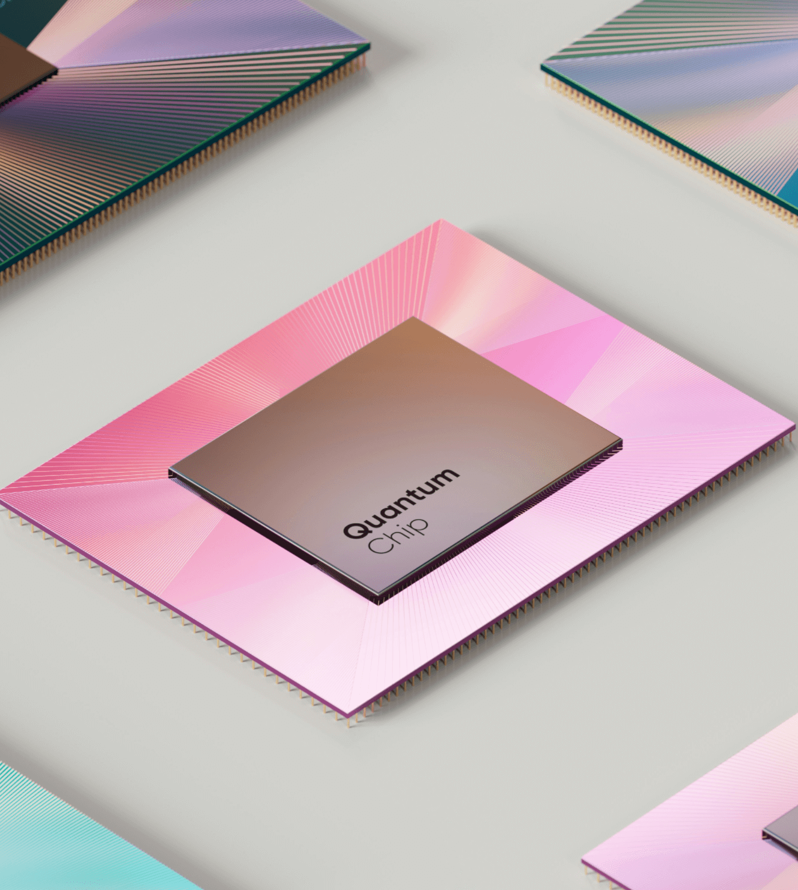
Technology Stack
PERN STACK
Frontend
React
Tailwind CSS
Axios
Backend
Node.js
Express.js
Database
PostgreSQl
AI Integration
Image Generation Models
NLP-based title generation

Slide 9
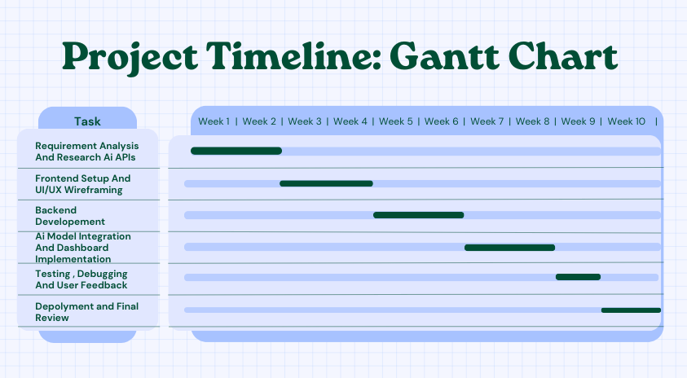
Project Planning
Total project duration: ~12 weeks
Followed Software Development Life Cycle (SDLC)
Phases:
Requirement Analysis
Frontend Setup
Backend Development
AI Integration
Testing
Deployment

Slide 10
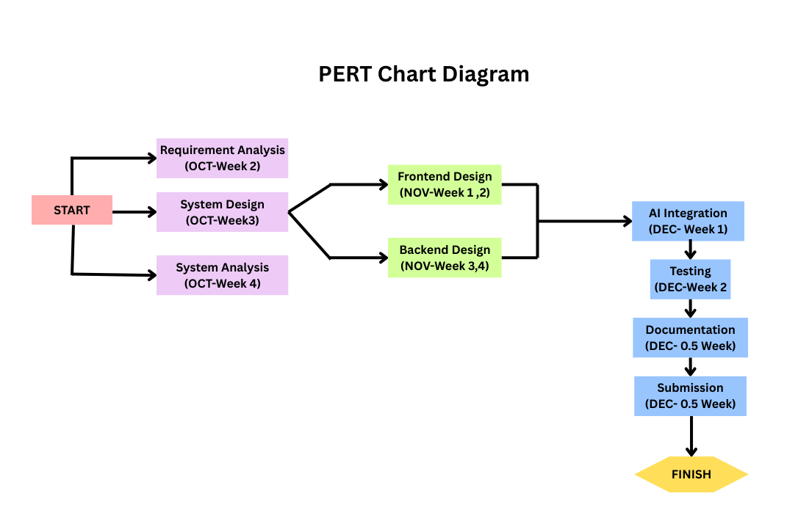
PERT Chart & Scheduling
Identifies task dependencies
Shows parallel development activities
Helps identify critical path
Ensures timely project completion

Slide 11
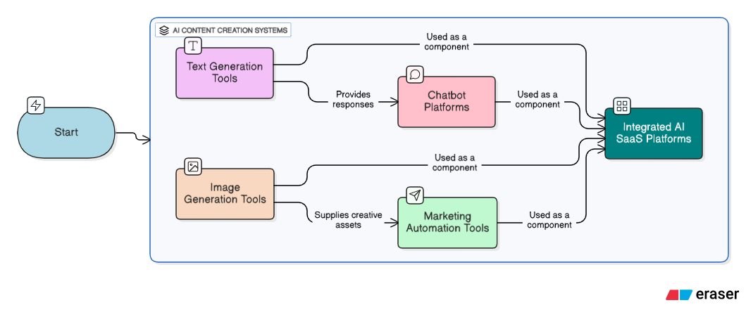
Block Diagram

Slide 12
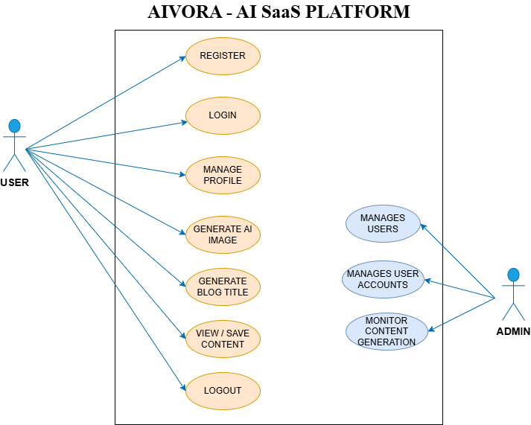
Use Case Diagram

Slide 13
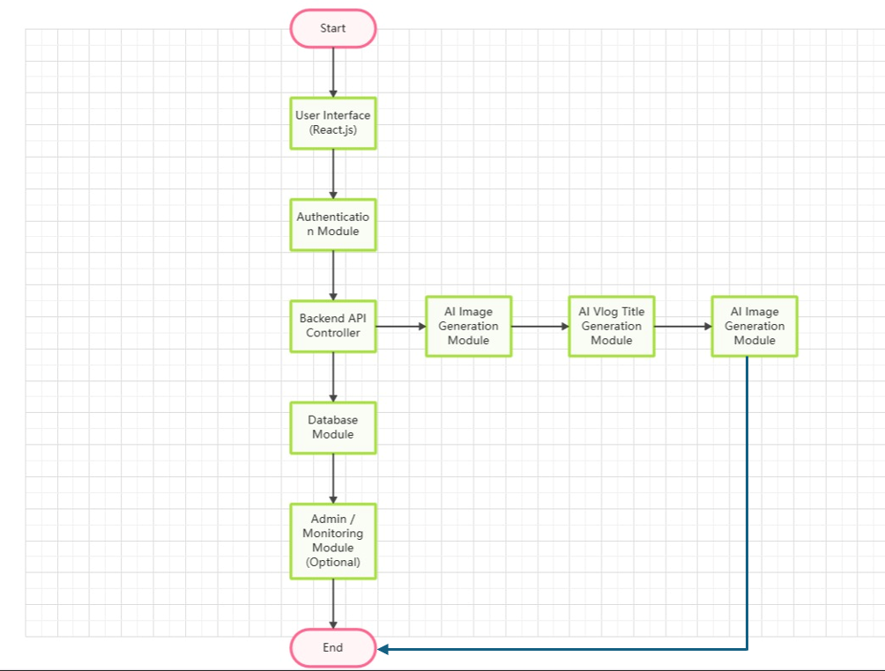
Module
Interaction Diagram

Slide 14
Implementation Overview
Backend APIs developed using Express.js
Secure authentication using token-based system
AI APIs integrated for images and titles
Frontend communicates via REST APIs
Dashboard stores user-generated content

Slide 15
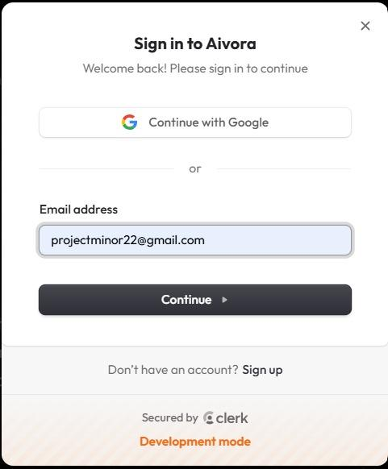
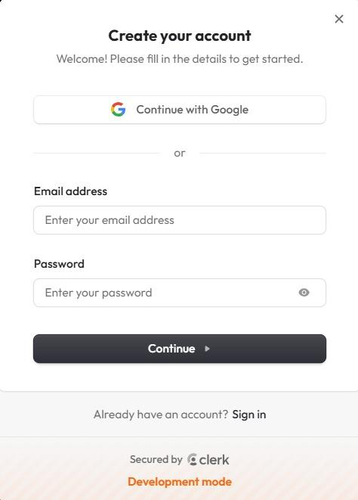
Login & Registration
01
03
Input validation and error handling
New users can register easily
Secure user authentication
02
Existing users can log in
04

Slide 16
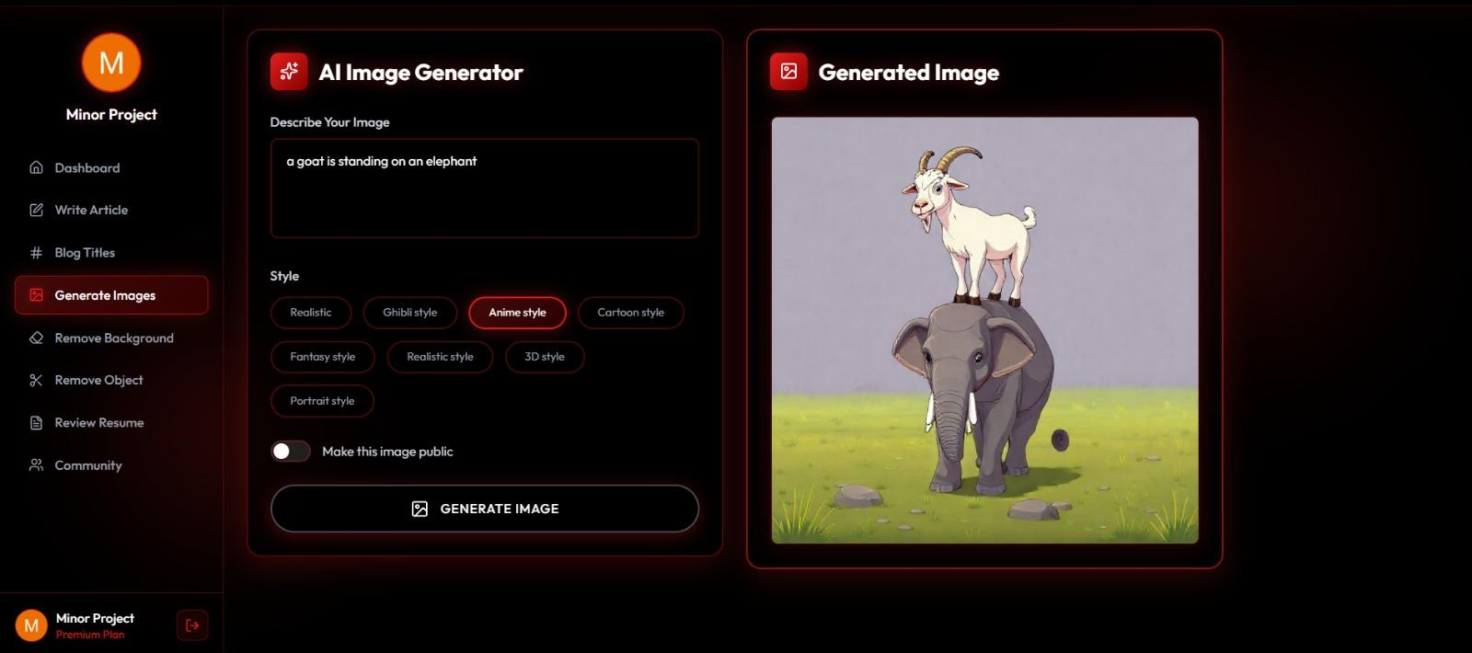
AI Image Generation
01
03
Suitable for branding and creativity
AI generates unique images
Users enter text prompts
02
Fast and automated process
04

Slide 17
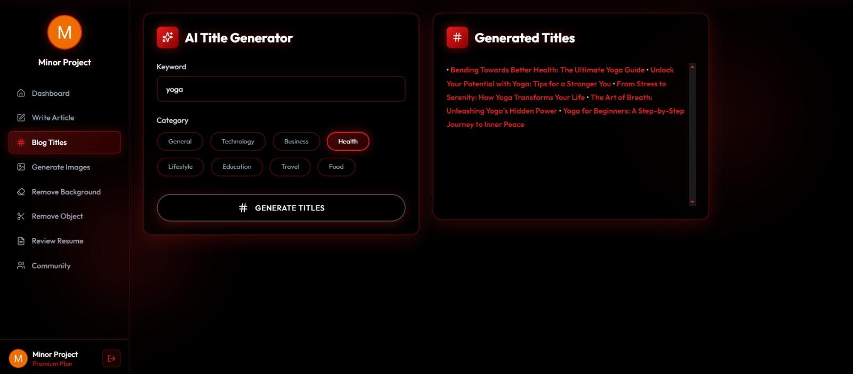
AI Blog Title Generator
01
03
Easy copy and reuse
Multiple creative options provided
Users enter keywords or topic
02
AI suggests SEO-friendly titles
04

Slide 18
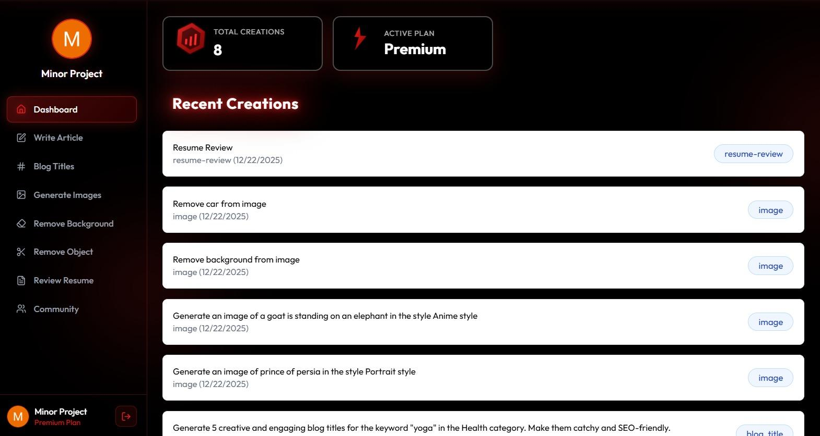
User Dashboard
01
03
Personalized user experience
Stores content history
Displays generated images and titles
02
Easy navigation and content management
04

Slide 19
Conclusion and Future Scope
Conclusion & Future Scope
Conclusion
Future Scope
AIVORA successfully integrates AI with SaaS
Simplifies content creation
Saves time and manual effort
Mobile application
Subscription & billing system
Advanced AI customization
Social media publishing integration

Slide 20


